Slide 1


Patterns of injury severity in firearm hospitalizations from 1993 to 2014: A repeated cross-sectional study
Yi Zuo, MPH
Center for Clinical Translational Epidemiology
and Comparative Effectiveness Research
Section of Preventive Medicine and Epidemiology
Department of Medicine
Boston University School of Medicine
Email: zuoyi@bu.edu

Slide 2
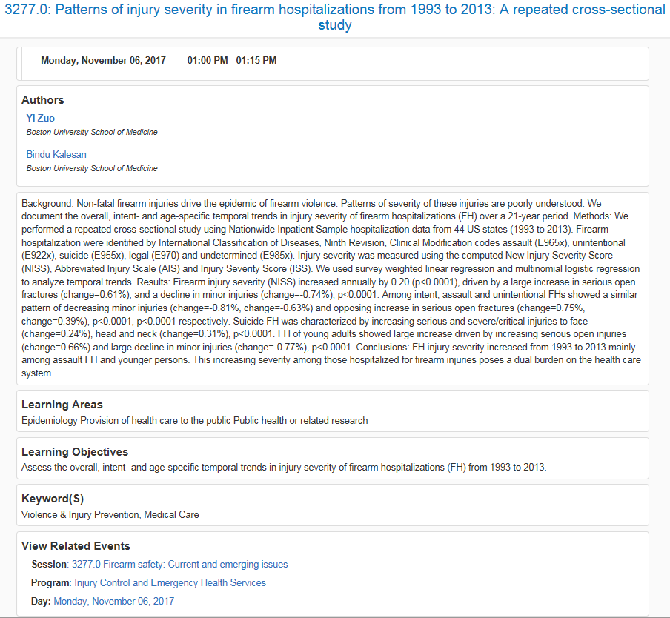
contents
Background
Methods
Results
Discussion
Conclusion
Acknowledgements: Drs. Bindu Kalesan, Ziming Xuan, Michael B Siegel, Jeffrey Fagan, Charles Branas, and Sandro Galea
Notes:
No screenshot reorder acknowledgements

Slide 3

background
Non-fatal firearm injuries constitute approximately 70% of all firearm trauma injuries in the United States.
Young adults more likely to be injured by assault; older adults self-inflicted
Patterns of severity of these injuries (overall, age-, sex-, and intent-specific) are poorly understood.
Notes:
Clearly state objective

Slide 4
METHODS Data Source Study Design
Nationwide Inpatient Sample (NIS) 1993-2014
Nationally representative claims
Represent 20% of all discharges in U.S.
Approximately 9 million records/year
Repeated cross-sectional study
Assess temporal trends of injury severity of firearm hospitalizations
Boston University School of Medicine IRB approved the study

Slide 5
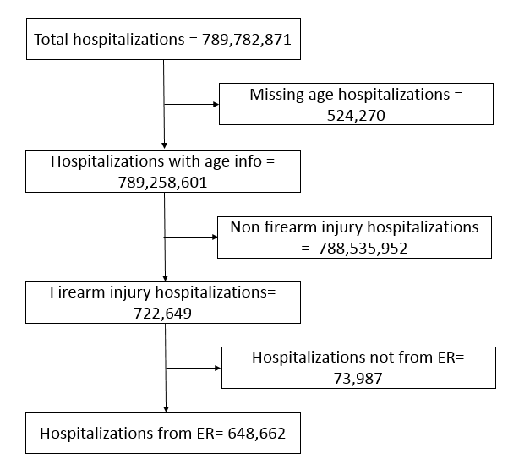
METHODS
Flow Chart
Survey weighted counts
1993-2014
Notes:
+ alive when admitted

Slide 6
METHODs Main Variables Other Variables
Computed New Injury Severity Score (NISS) – continuous variable (0-75)
Age group – categorical variable: the pediatric (0-15); young adults (16-45); older adults (45+)
Sex – binary variable: female, male
Intent – categorical variable: assault, suicide, unintentional and undetermined
Race/ethnicity
Insurance
Median neighborhood income quartiles
Comorbidities
Elixhauser comorbidity score
Hospital location
Hospital teaching status
Hospital bed size
Hospital region
Notes:
Q: why 16-45?

Slide 7
METHODs Statistical Analysis
Calculated NISS from Stata package ICDPIC Version 3.0, and made margins plots
Used survey weighted multilevel mixed effects generalized linear model (Gaussian family) with NISS as a linear dependent variable, year as a factor term and stratum as the random intercept.
Used the predicted shrinkage Bayes estimates to calculate the annual mean and SE
Used Joinpoint Regression Program from SEER for joinpoint analysis
Notes:
Q: Why random intercept?

Slide 8
Results Types of Intent
Notes:
Change color

Slide 9

Results Patient Profile
Male
Black
16-45 years old
Medicaid
Low-income neighborhoods

Slide 10

Results Hospital Profile
Urban
Teaching
Large bed size
Located in the south of the country

Slide 11
results Overall NISS Trend
Notes:
High score: chest head; low scores: extremity

Slide 12
results NISS Trend by Age Groups

Slide 13
results NISS Trend by Sex
Notes:
P value for difference?

Slide 14
results NISS Trend by Intent

Slide 15
Discussion Findings
An overall increase in injury severity among firearm hospitalizations from 1993 to 2014 (Sauaia 2013, Farst 2013, de Guise 2014, and Missikode 2015)
Better medical care that saves more lives
Injuries being better treated and discharged in the emergency room and trauma centers without being hospitalized
Increasing severity of firearm injuries, potentially reflects both changes in firearm injury and in hospitalization patterns, and may result in long term morbidity and disability, thereby increasing overall health care costs.

Slide 16
Discussion Findings
Children (0-15 years): a large annual increase among from 1993 to 1995, plateaued briefly between 1995 and 1998, followed by a more steady but smaller annual increase from 1998 to 2014
It indicates the potential for prolonged disability and loss of productivity in young people.
Notes:
Children had less severity mainly unintentional

Slide 17
Discussion Findings
Increase in both sexes
About 88% of firearm hospitalizations were male.

Slide 18
Discussion Findings
Increase in all types of intent
Driven by the rising trends among assault firearm hospitalizations
Greater severity in suicide
Notes:
Assaultive

Slide 19
Discussion Limitations
Lack of patient specific identifiers to identify index versus re-hospitalizations
Lack of detailed integrated information regarding emergency department visits
Missing race/ethnicity information
Fewer states in earlier years
Changes in usage and application of NISS overtime

Slide 20
Conclusion
In conclusion, our data show growing injury severity among firearm hospitalizations over time. Surviving gun shots does not mean that people have completely recovered. The majority of them will live compromised lives with repeated emergency and hospitalization visits, psychological problems, and social challenges.
Simply put, our study demonstrates not only the public health burden due to non-fatal gun injuries, but also the direct burden of continued and multiple challenges to the individual.
Notes:
Suggests instead of demonstrate
No

Slide 21
Questions?

Slide 22

THANK YOU!
Our website: http://sites.bu.edu/tec/

